Slide 1


OVERVIEW

Slide 2


THE CLIPP STORY
Clipp is a response-driven co-operative mail magazine built around local audience expertise that is proven to increase visibility, traffic, sales and new customer acquisition for businesses large and small.

Slide 3
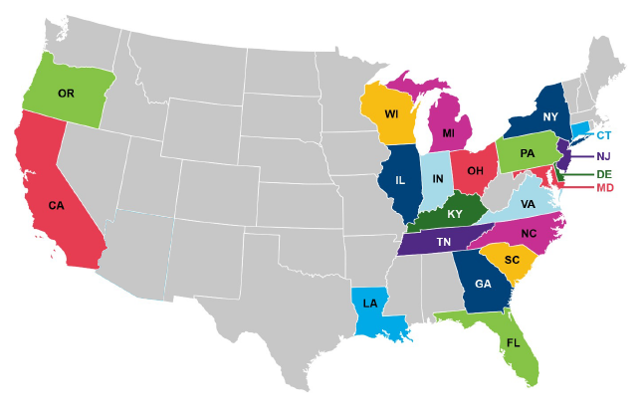

TOTAL DISTRIBUTION: CLIPP
21
states
413
local publications

Slide 4

OPEN & LOOK THROUGH
AMONG HOUSEHOLDS RECEIVING THE PUBLICATION
92%
74%
OPEN
LOOK THROUGH ENTIRE PUBLICATION
Q: When you receive _____ Magazine, what usually happens? n=1,351
Q: Which of the following best describes how extensively you look through _____ Magazine? n=1,351
Notes:
Look at New Media Kit for Partners – Ask Terri

Slide 5

ENGAGEMENT & SHELF LIFE
74%
55%
65%
44%
SPEND 3-10 MINUTES LOOKING THROUGH THE MAGAZINE
LOOK THROUGH2-3X
KEEP FOR AT LEAST 1 WEEK – 1 MONTH; OR UNTIL RECEIVING THE NEXT PUBLICATION
Keep in the kitchen
54% spend 3-10 minutes looking through direct mail in general (postcards, envelopes, or flyers)
1x: 36%
2x: 41%
3x: 14%
4x: 3%
5x: 3%
Don't know/not sure: 3%
20% keep <1 week
3% keep 2+ months
11% varies by expiration date
Kitchen counter: 34%
On the refrigerator: 10%
Dining room/kitchen table: 1%
In a drawer: 22%
With other mail: 15%
In car: 8%
In wallet/purse: 3%
In a coupon folder/envelope/organizer: 2%
Coffee table/living room: 2%
Office: 1%
Other, please specify: 1%
Q: How much time do you typically spend looking through _____ Magazine? n=1,185
Q: How many times do you look through your _____ Magazine? n=1,185
Q: How long do you usually keep ____ Magazine or any of the coupons inside? n=1,185
Q: Where do you typically keep your ____ Magazine or any of the coupons? n=1,185

Slide 6
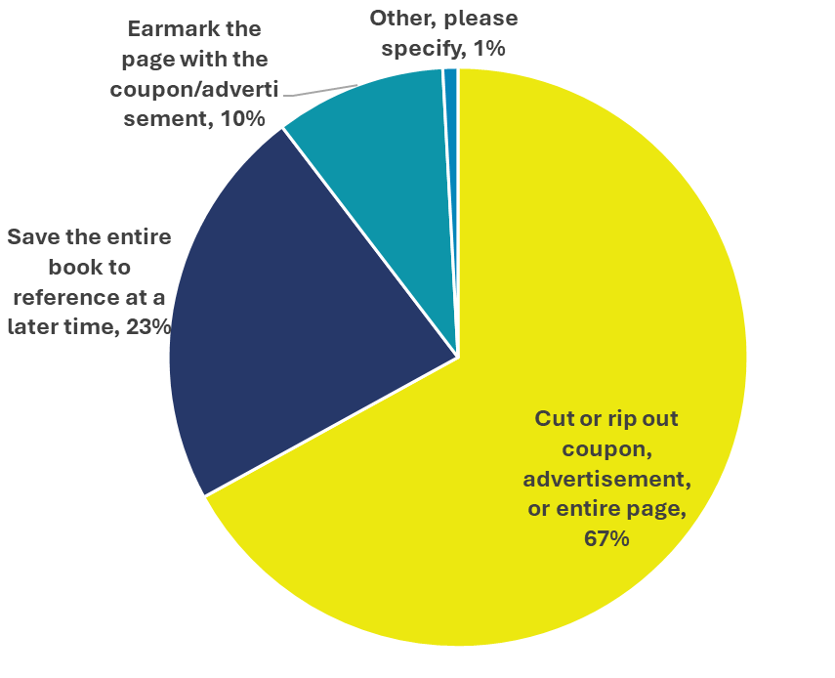
PUBLICATION COUPON USAGE
Nearly 7 in 10 cut or rip out the advertisement
AMONG CONSUMERS OPENING THE PUBLICATION
92%
SET ASIDE 1-5 COUPONS
68%
USE COUPONS ONCE A MONTH OR MORE FREQUENTLY
Q: Approximately how many coupons do you typically set aside from _____ Magazine with the intent of using or sharing, regardless of whether you use them? (If you are unsure, please provide your best guess.) n=1,185
Q: Which of the following best describes how often you use a coupon from ____Magazine? n=1,185
Q: How do you typically set aside coupons from _____ Magazine that you are interested in using? n=1,185
Notes:
Look at New Media Kit for Partners – Ask Terri

Slide 7
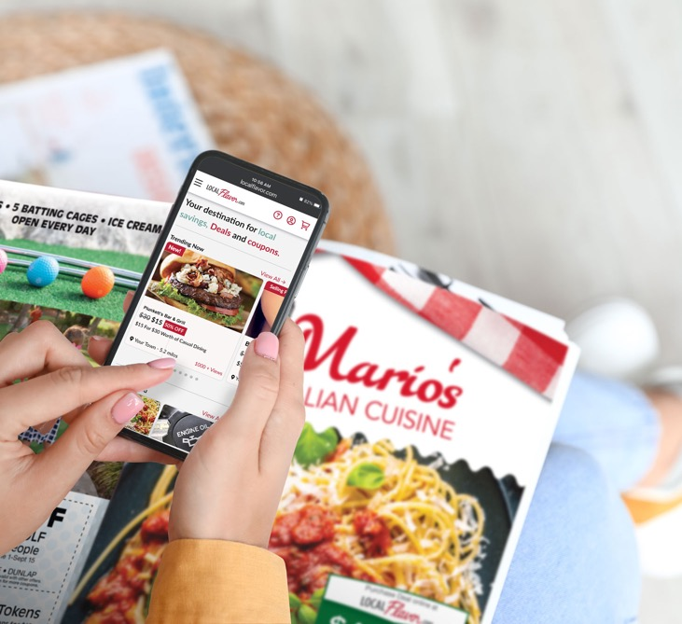
CONSUMER FAVORITES: TOP CATEGORIES
Rank | Category
1 | Groceries or Grocery Stores
2 | Fast-Food or Quick Serve Restaurants
3 | Sit-Down Restaurants
4 | Big Box Retailers (e.g., Walmart, Target, etc.)
5 | Clothing or Department Stores
6 | Entertainment
7 | Pet Care Products or Services
8 | Beauty Supplies or Services
9 | Specialty Retail (e.g., Florists, Jewelry, Greeting Cards, etc.)
10 | Automotive Sales or Services
11 | Furniture or Home Stores
12 | Home Services / Remodeling
13 | Medical or Health & Wellness
14 | Ecommerce (Online) Retailers
15 | Banking, Financial Services or Real Estate
*Image NOT shown to respondents
Q: Please rank the following types of coupons you would most like to see inside _____ Magazine on a scale of 1 to 15 where “1” is the most appealing and “15” is the least appealing. By appealing, please think about the coupon’s usefulness. n=1,185

Slide 8
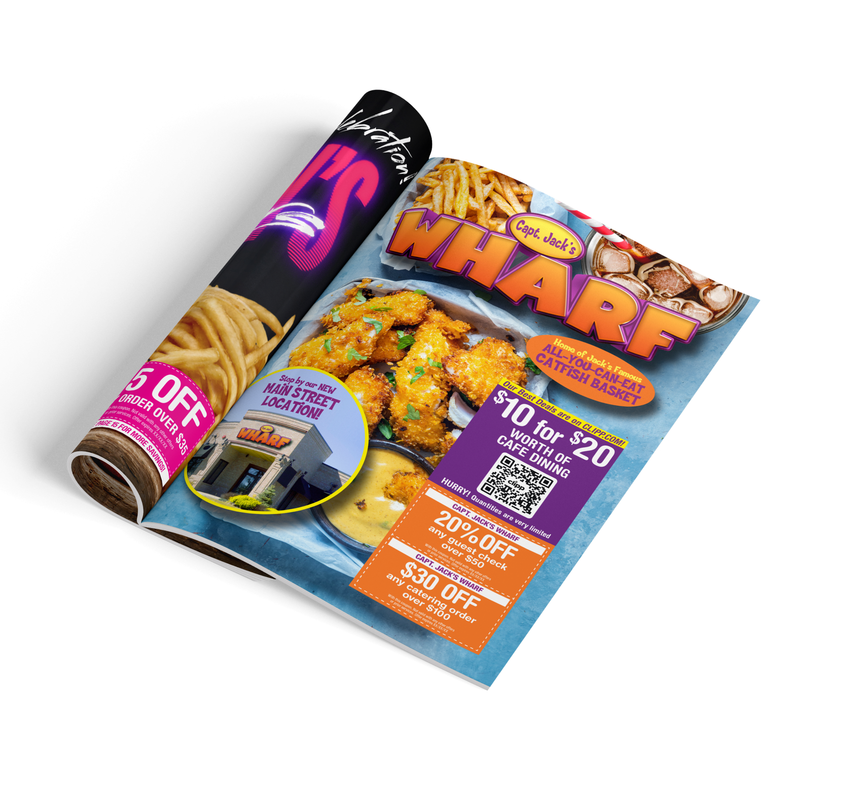

AD SIZES:
Front & Back Cover
2-Page Spreads
Full
Half
Third

Slide 10


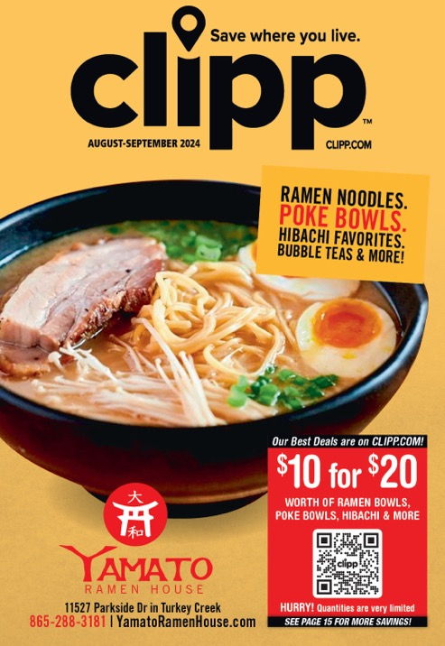



Slide 11
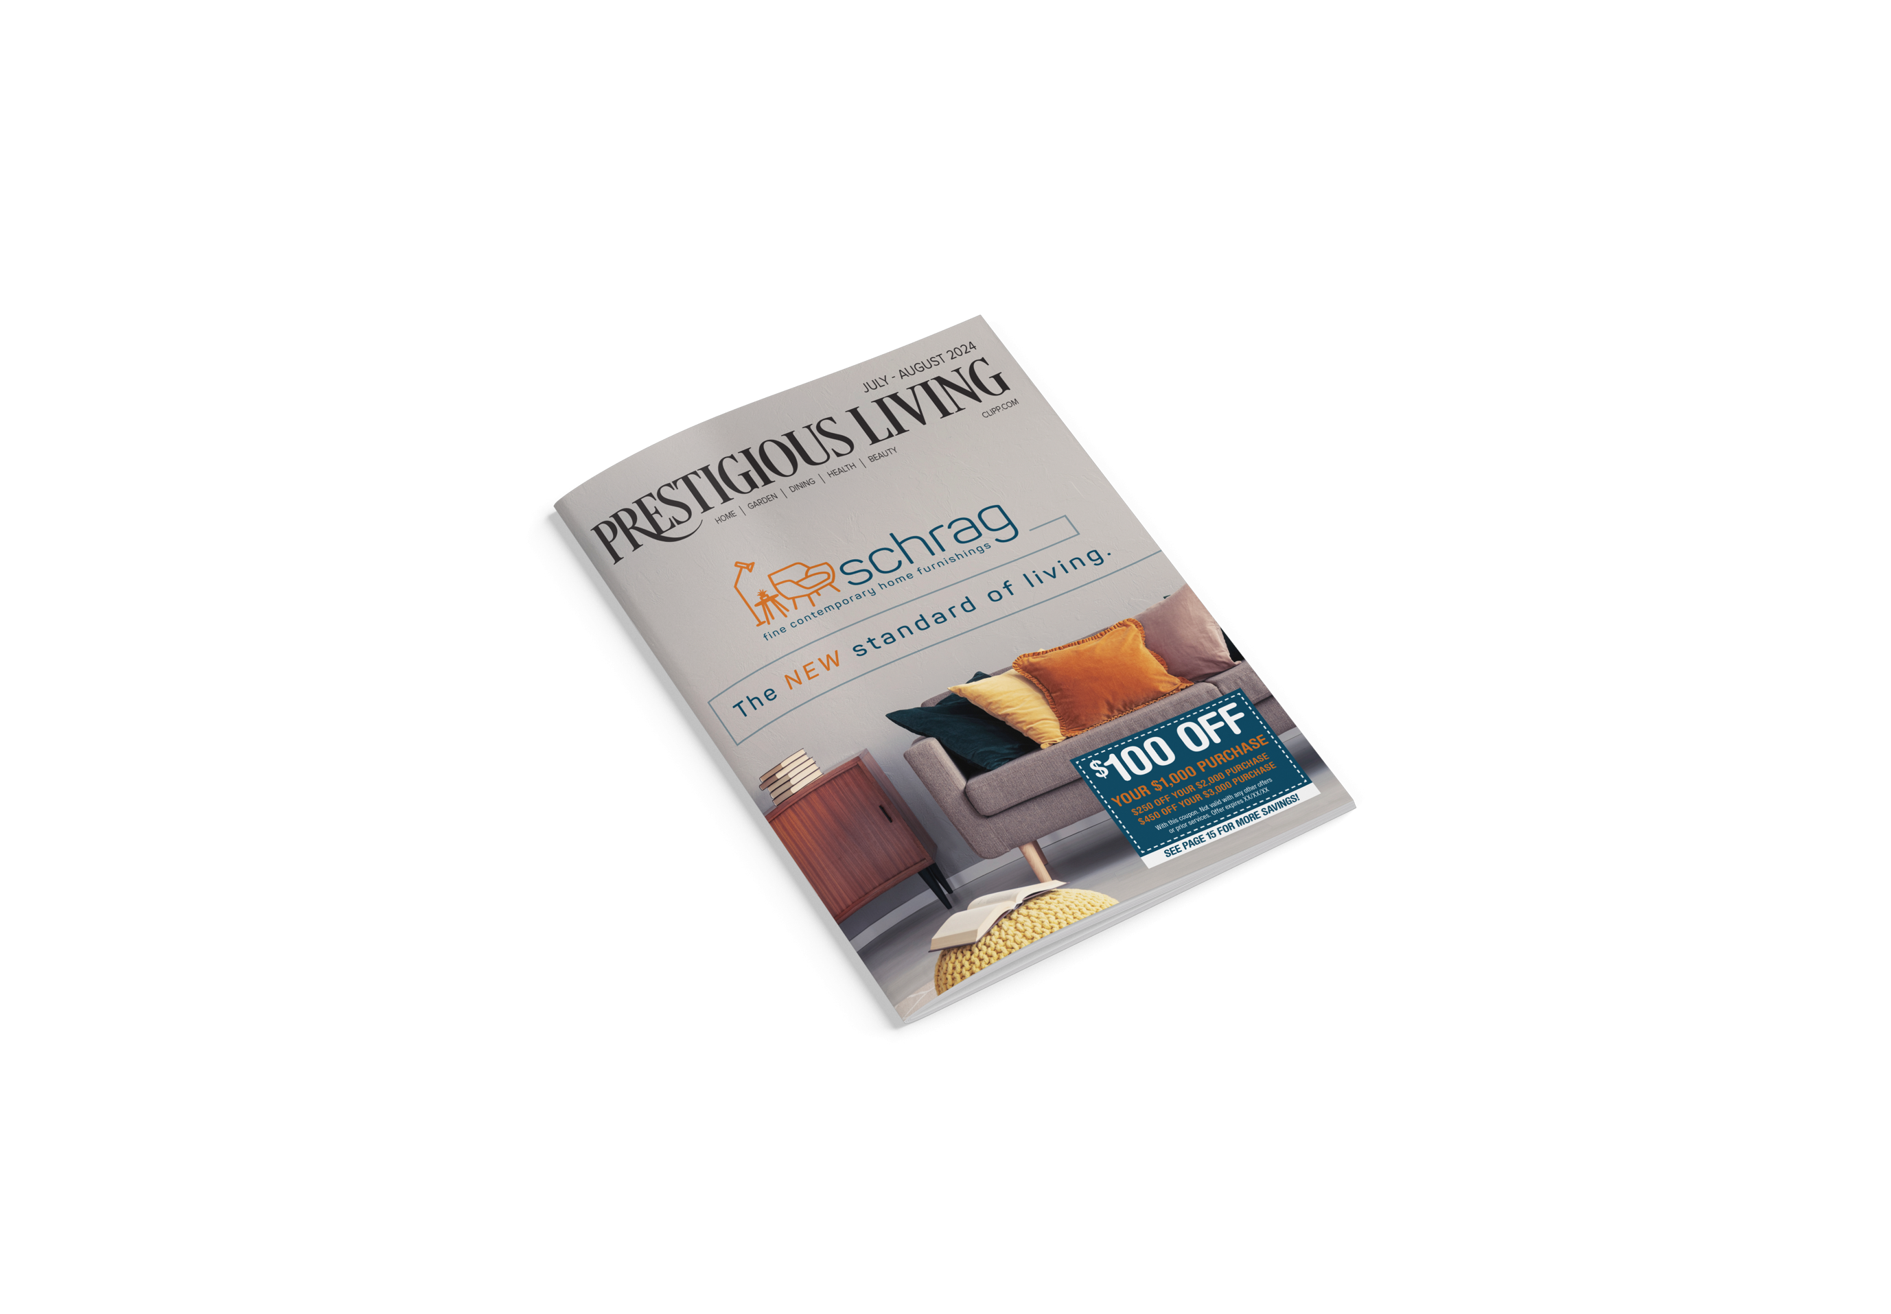
Hartford County, CT
  4 issues — 71,000 homes
Cincinnati/Northern Kentucky
  8 issues — 254,000 homes
Susquehanna Valley, PA
  4 issues — 70,000 homes
Capital Region, PA
  2 issues — 70,000 homes
Baltimore, MD
  2 issues — 71,000 homes
Jacksonville, FL
  10 issues — 144,000 homes

Slide 12

DATA-DRIVEN
DIRECT MARKETING
Clipp combines geographic targeting, consumer
behavior profiling, demographic data and
purchase power to help your business:
1. Identify your ideal audience
2. Create customer profiles
3. Apply profiles to geographies
Our research services include consultations, targeting recommendations, custom profiling, competitive intelligence, post-analysis reporting and ad-hoc market research requests.

Slide 13

MORE DIGITAL
SOLUTIONS
DIGITAL DISPLAY
Offers businesses the ability to optimize the success of print campaigns by re-targeting household devices of mailed audiences through data.
CONNECTED TV
Non-skippable, immersive content that runs on any device using apps to deliver TV content

Slide 14
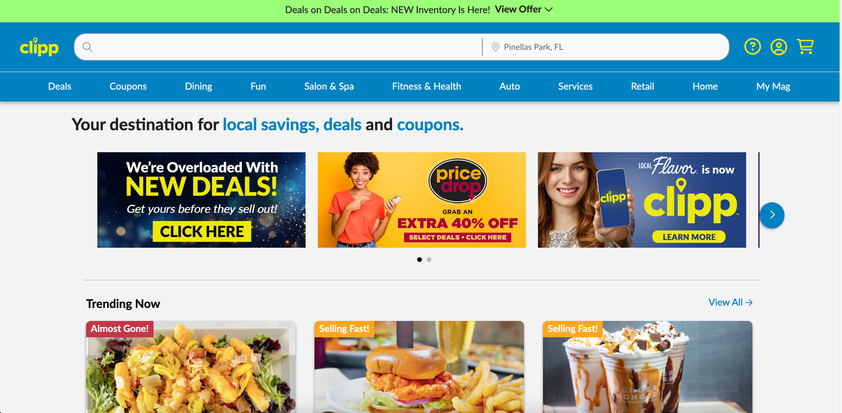

Slide 15
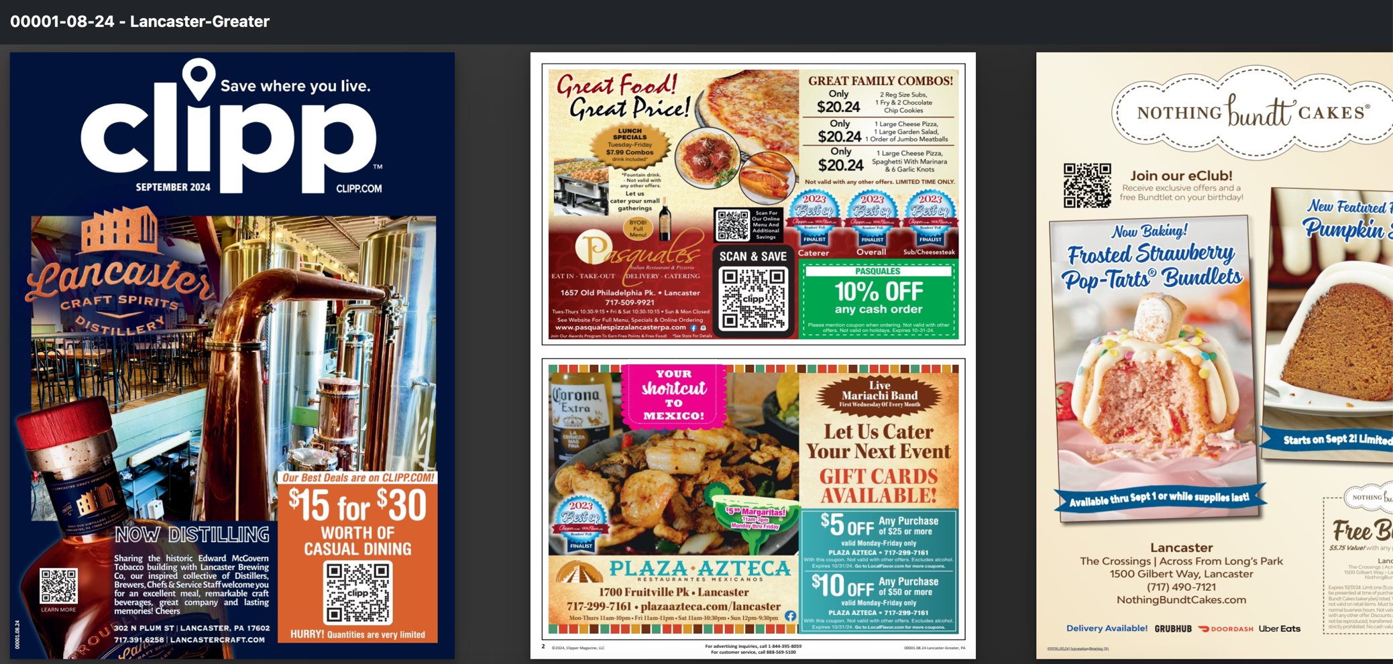

Slide 16




Slide 17
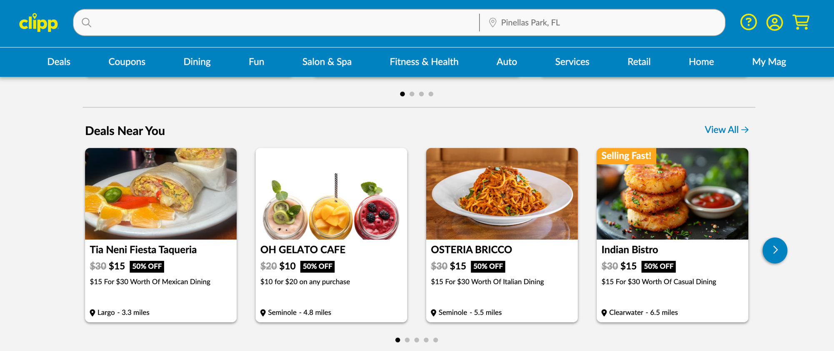

Slide 18
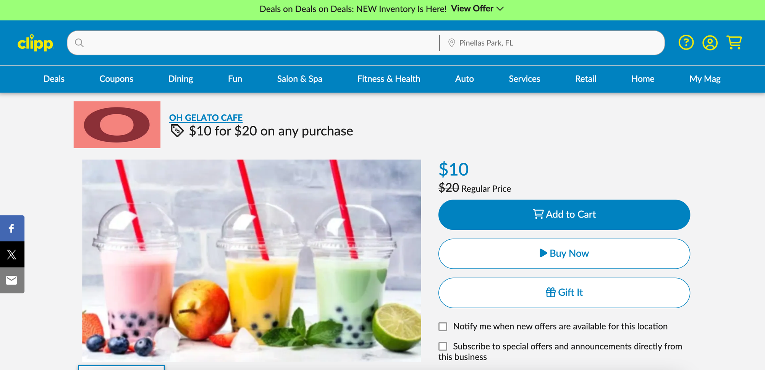

Slide 19

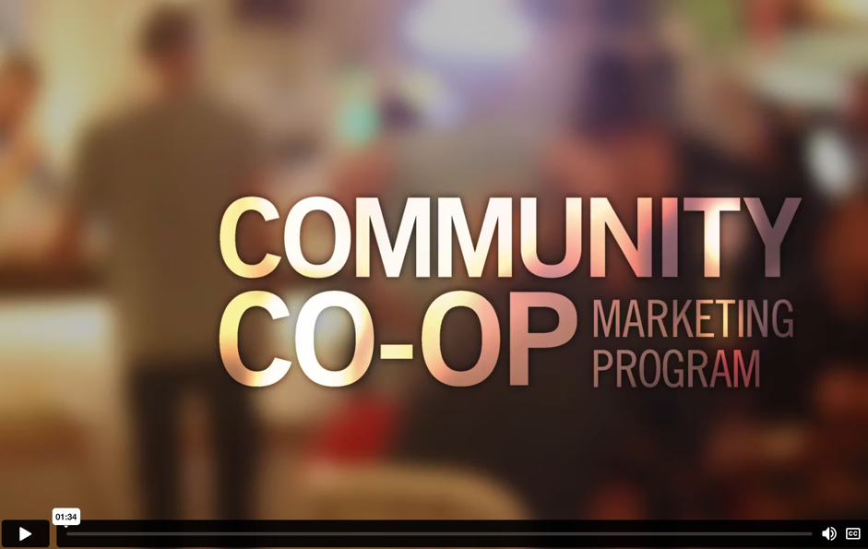

Slide 21
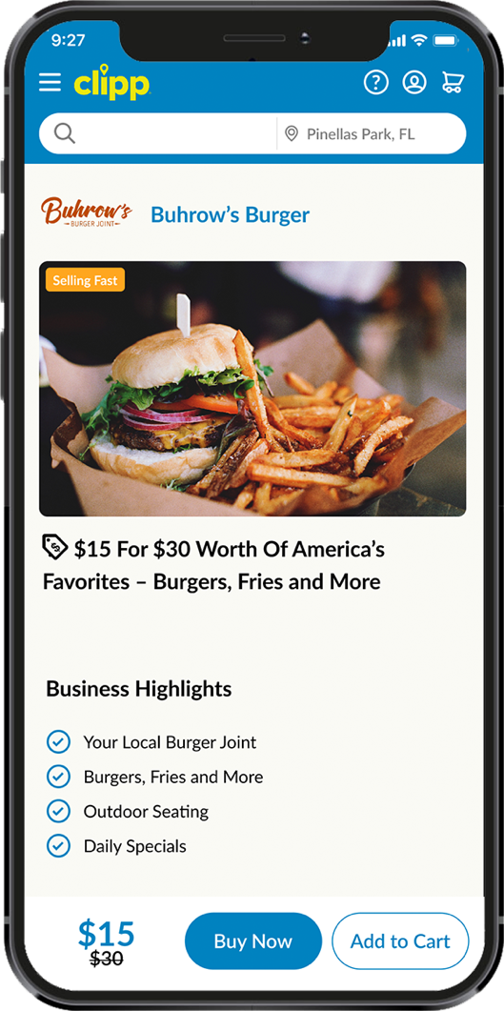
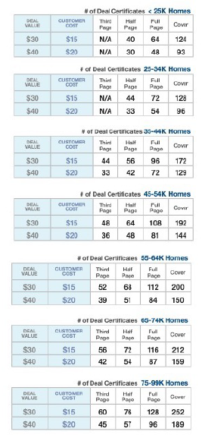
Get a gorgeous direct mail ad with online and mobile exposure, plus email marketing
100% RISK FREE!

Slide 22
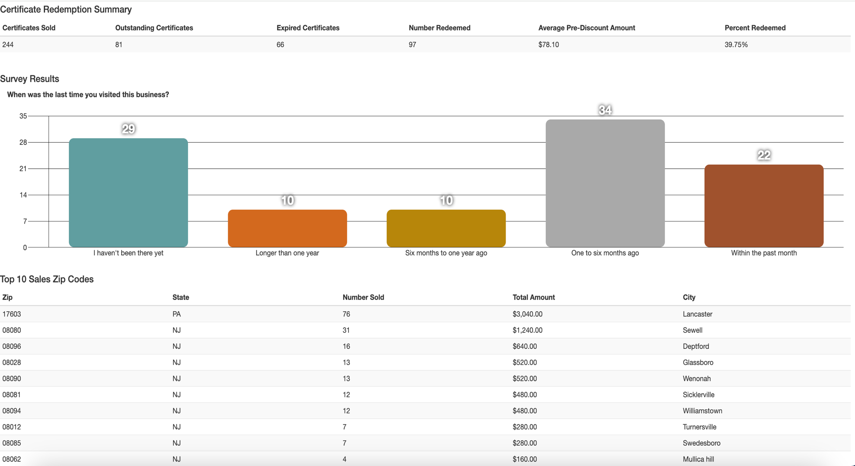

Slide 23
THANK YOU!

